Slide 1
Title Keyword Analysis Using Google Trends
Presented By Group 3
Choki Gyeltshen
Tshenden Wangchuk
Kelzang Wangmo
Guided By
Miss Supriya Jadhav
Senior Data Scientist
Ex. Serviceman

Slide 2
Algorithm
Step 2
Data extraction using Google Trend
Step 3
Step 4
Country wise Analysis
Last 7-days keyword performance
Related keywords
Geographical breakdown
Time-series data (2013-2024)
Data Preprocessing using DAX
Data extraction
Error handling
Null handling
Columns naming
Time Dependent Analysis
Keyword Analysis
Real Time Analysis
Power BI desktop to create dashboard
Power query interface
Advance power query for parameter creation
Table operation
Filtering
Step 1
SERP API to generate API key
Extracted data using API key

Slide 3
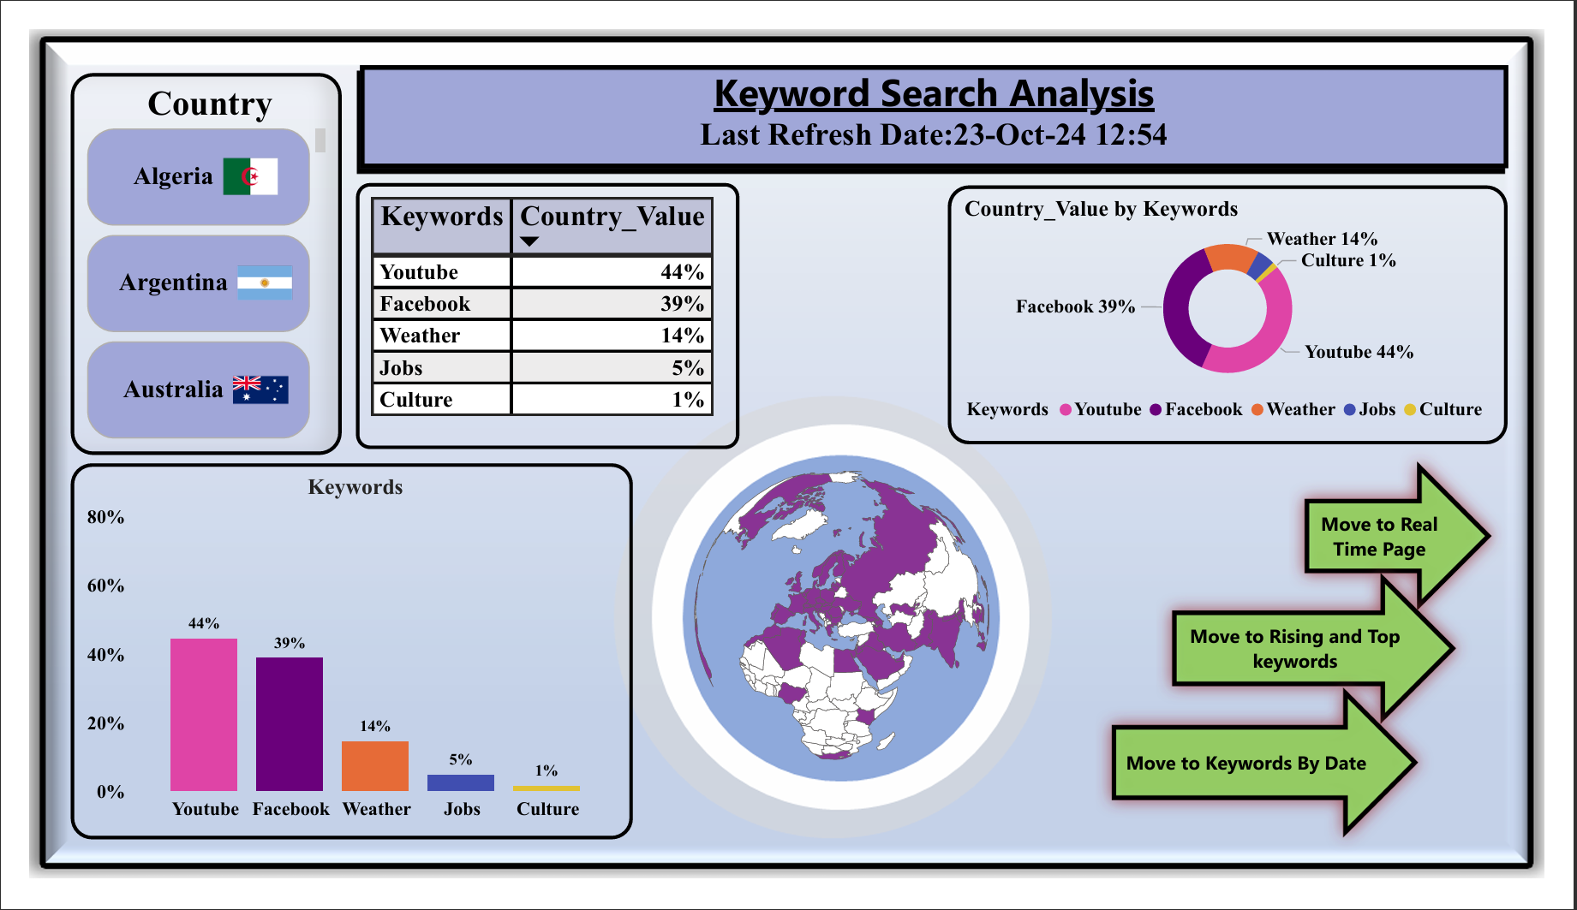
Question 1

Slide 4
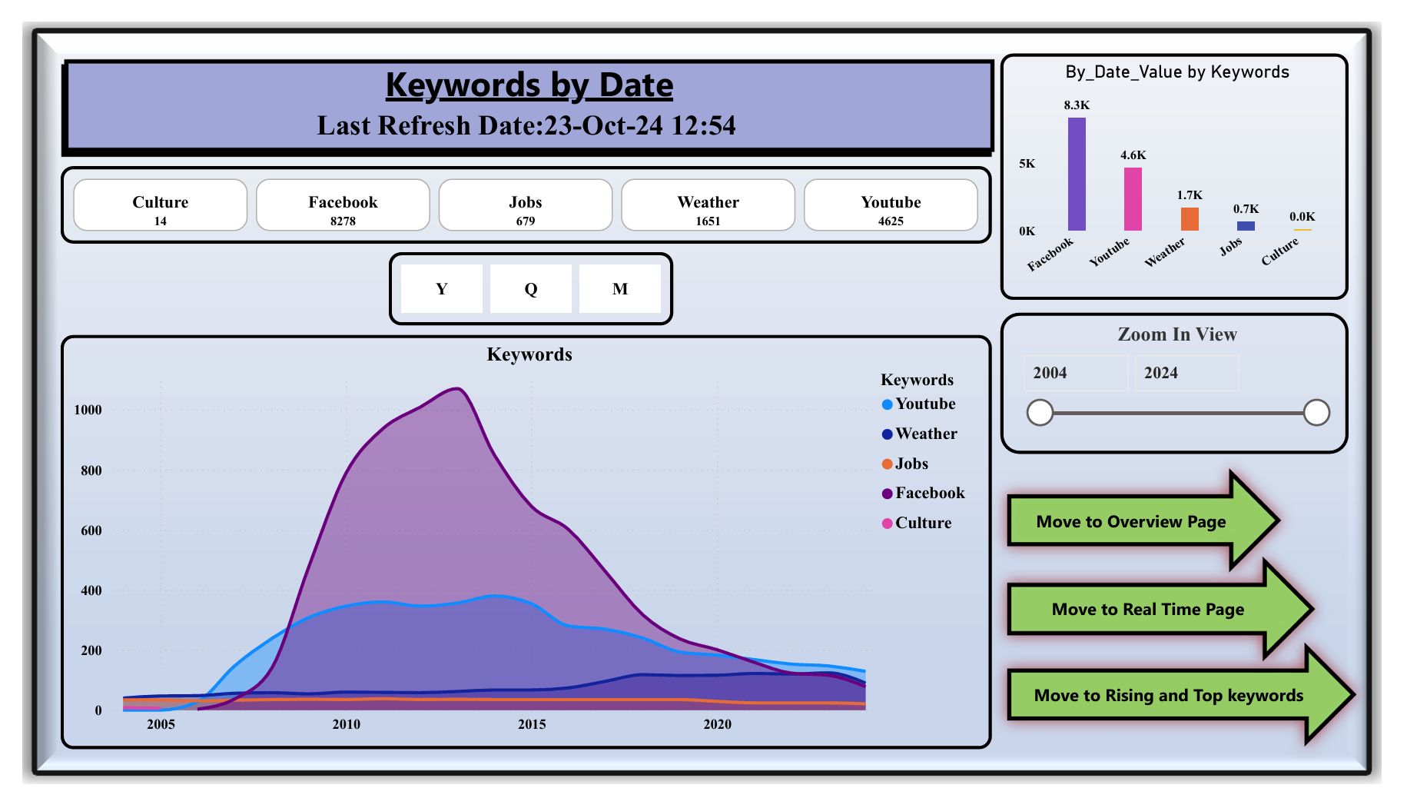
Question 2

Slide 5
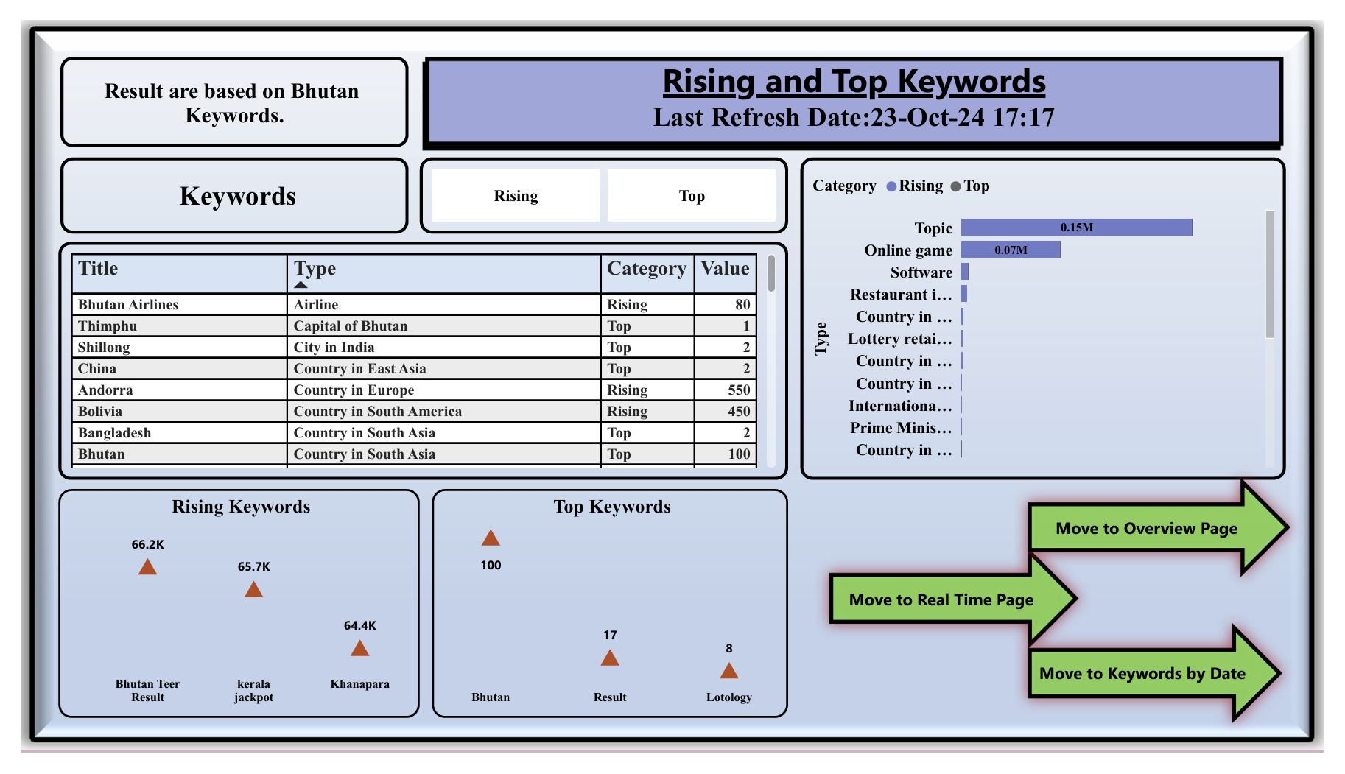
Question 3

Slide 6
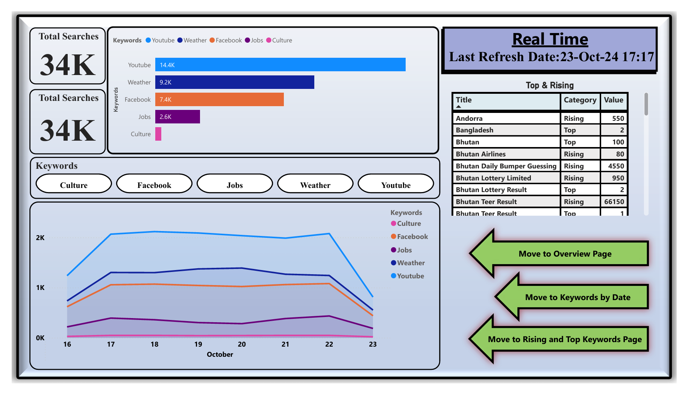
Question 4

Slide 7
Technologies Used
Mapping
Slicer
Charts Creation
Tables
Buttons
Drill Through
Aesthetics for each visuals
Card
3D Effects
Advance Editor
SERP Google Trends

Slide 8

WE ARE OPEN FOR QUESTIONS!

